Slide 1
Spreadsheet Analysis Presentation
Amber & Jabin

Slide 2
Planning Stage
Made contact by creating a huddle group and introducing ourselves.
Downloaded our sales.csv file ready to extract and identify data.
Team member down so planning stage became even crucial even more so. Ensured that the must have criteria was implemented for the project first and if time constraints allowed we would continue to develop.
Analysed the data to understand what figures we were dealing with.
Huddle call to start working on the project together.
We both worked together and shared queries to ensure that we both agreed and helped each other out.

Slide 3
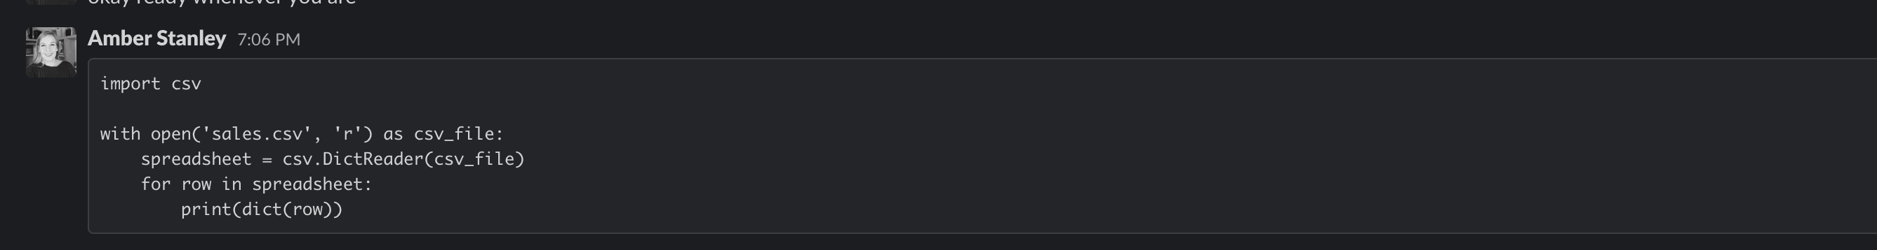
Task 1 – CSV File
Our first task was to upload the .csv file onto python.
Jabin tried to upload the .csv files but continued to get errors. Amber found this an easy task and managed to upload the .csv file, this was then shared and the .csv file uploaded.

Slide 4
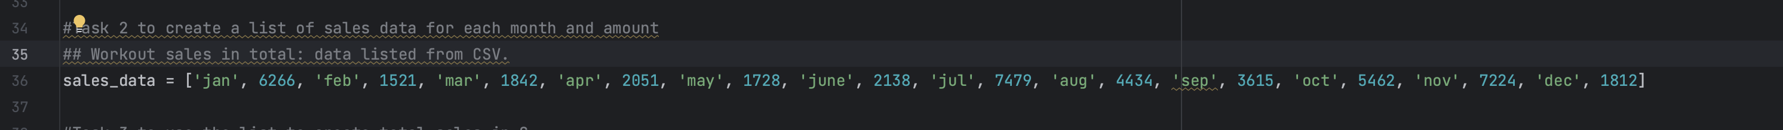
Task 2 – List data
At first data was listed manually and then led to task 3. Though this worked well and led to the calculation for Task 3. We realised that this would not work with a large dataset.

Slide 5
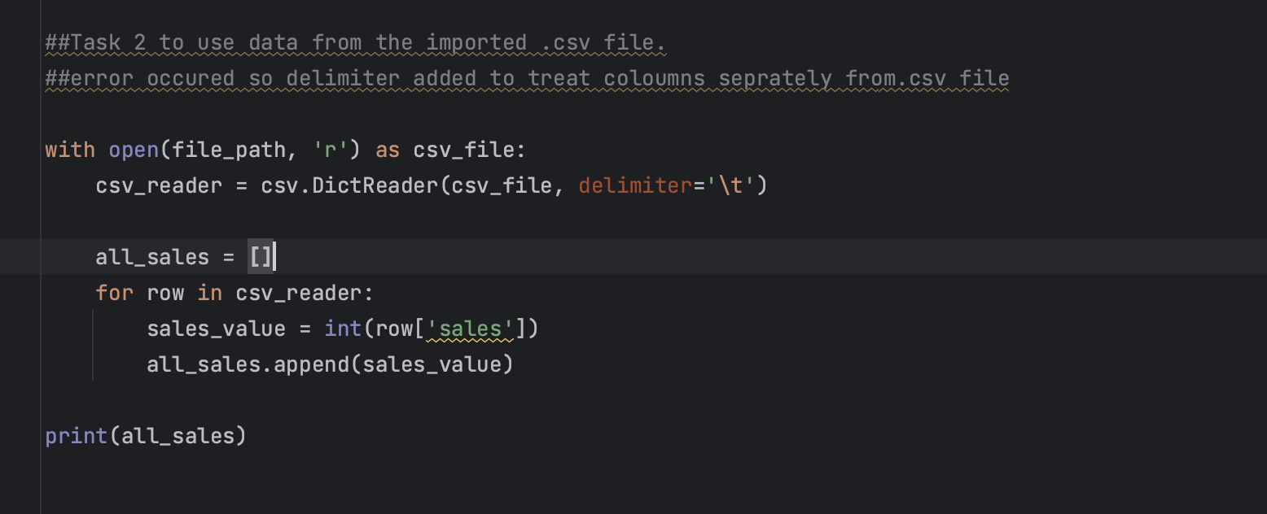
Task 2 – List data
We began researching, going back through our PPTs and using google to help us find the correct query to be able to import the data from our .csv file rather then the manual input.

Slide 6
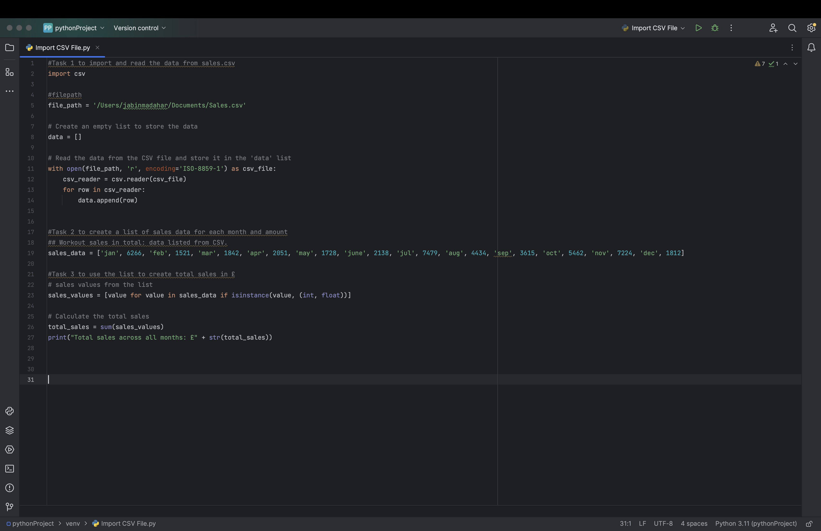
Task 3 – Use list
To use our list to find out the total number of sales. The query placed in pycharm is as follows:

Slide 7
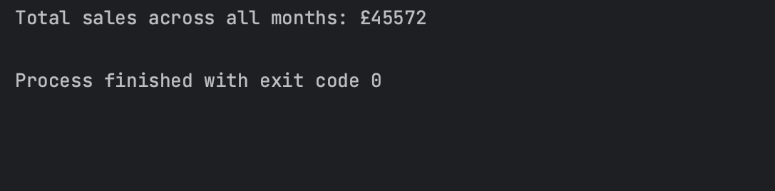
Task 3 – Use list
Our query worked successfully as the output has shown the total sales:

Slide 8
Thank you for listening
Thank you to the instructors for your help, support, patience and quality of teaching it is greatly appreciated!

